Slide 1
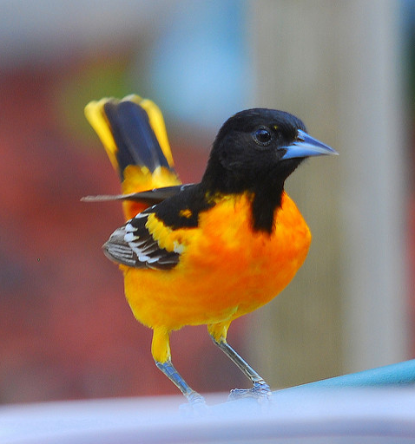
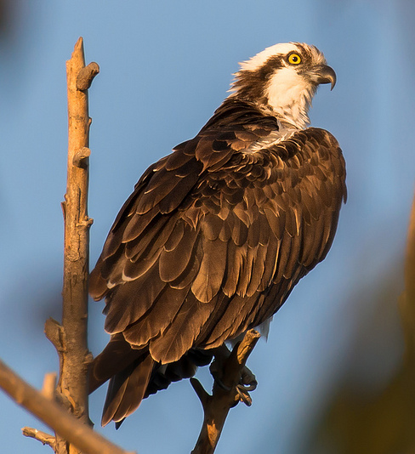
Baltimore Oriole
Osprey
Kasjun CC BY-NC-SA 2.0
Hrishi Chandanpurkar CC BY-NC-SA 2.0

Slide 2



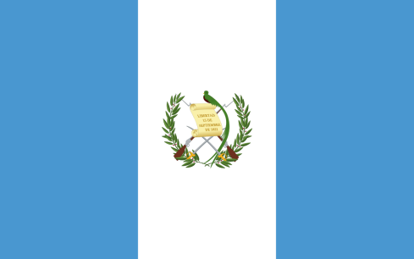

Osprey
Pandion haliaetus
Águila Pescadora
Baltimore Oriole
Icterus galbula
Turpial de Baltimore
Spring/Summer:
Winter:
Spring/Summer:
Winter:
Maryland, USA
Maryland, USA
Brazil
Venezuela
Guatemala
Honduras

Slide 3
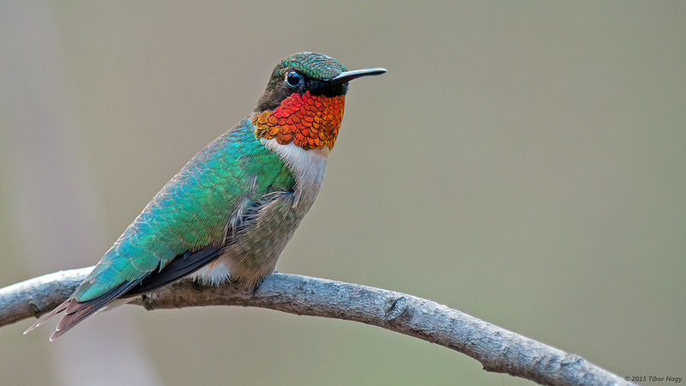
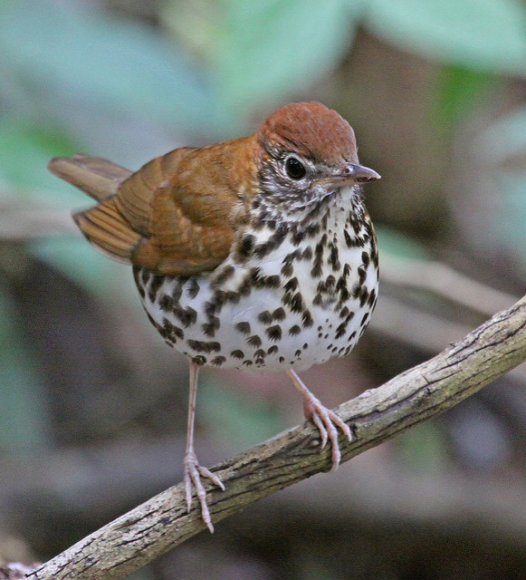
Ruby-throated Hummingbird
Wood Thrush
Tibor Nagy CC BY-NC- 2.0
Jerry Oldenettel CC BY-NC-SA 2.0

Slide 4




Wood Thrush
Hylocichla mustelina
Zorzalito Maculado
Ruby-throated Hummingbird
Archilochus colubris
Colibrí Gorjirrubí
Spring/Summer:
Winter:
Spring/Summer:
Winter:
Maryland, USA
Maryland, USA
Belize
Mexico
Costa Rica
El Salvador

